Slide 1


Introduction to the
Well Badger Resource Center
Becca Wyland, CRS
Well Badger Information & Referral Specialist
Wisconsin Women’s Health Foundation
Notes:
Tommi or Lisette
Welcome & Introductions

Slide 2





About Well Badger
Well Badger provides health information & referral services to individuals, families, and health professionals throughout the state
Managed by Wisconsin Women’s Health Foundation
  20+ year history of providing free health education and support programs to women and their families throughout Wisconsin
  Operational all 72 counties and 11 tribes
  Main office in Madison with staff located throughout the state
Funded by WI Department of Health Services, including:

Slide 3

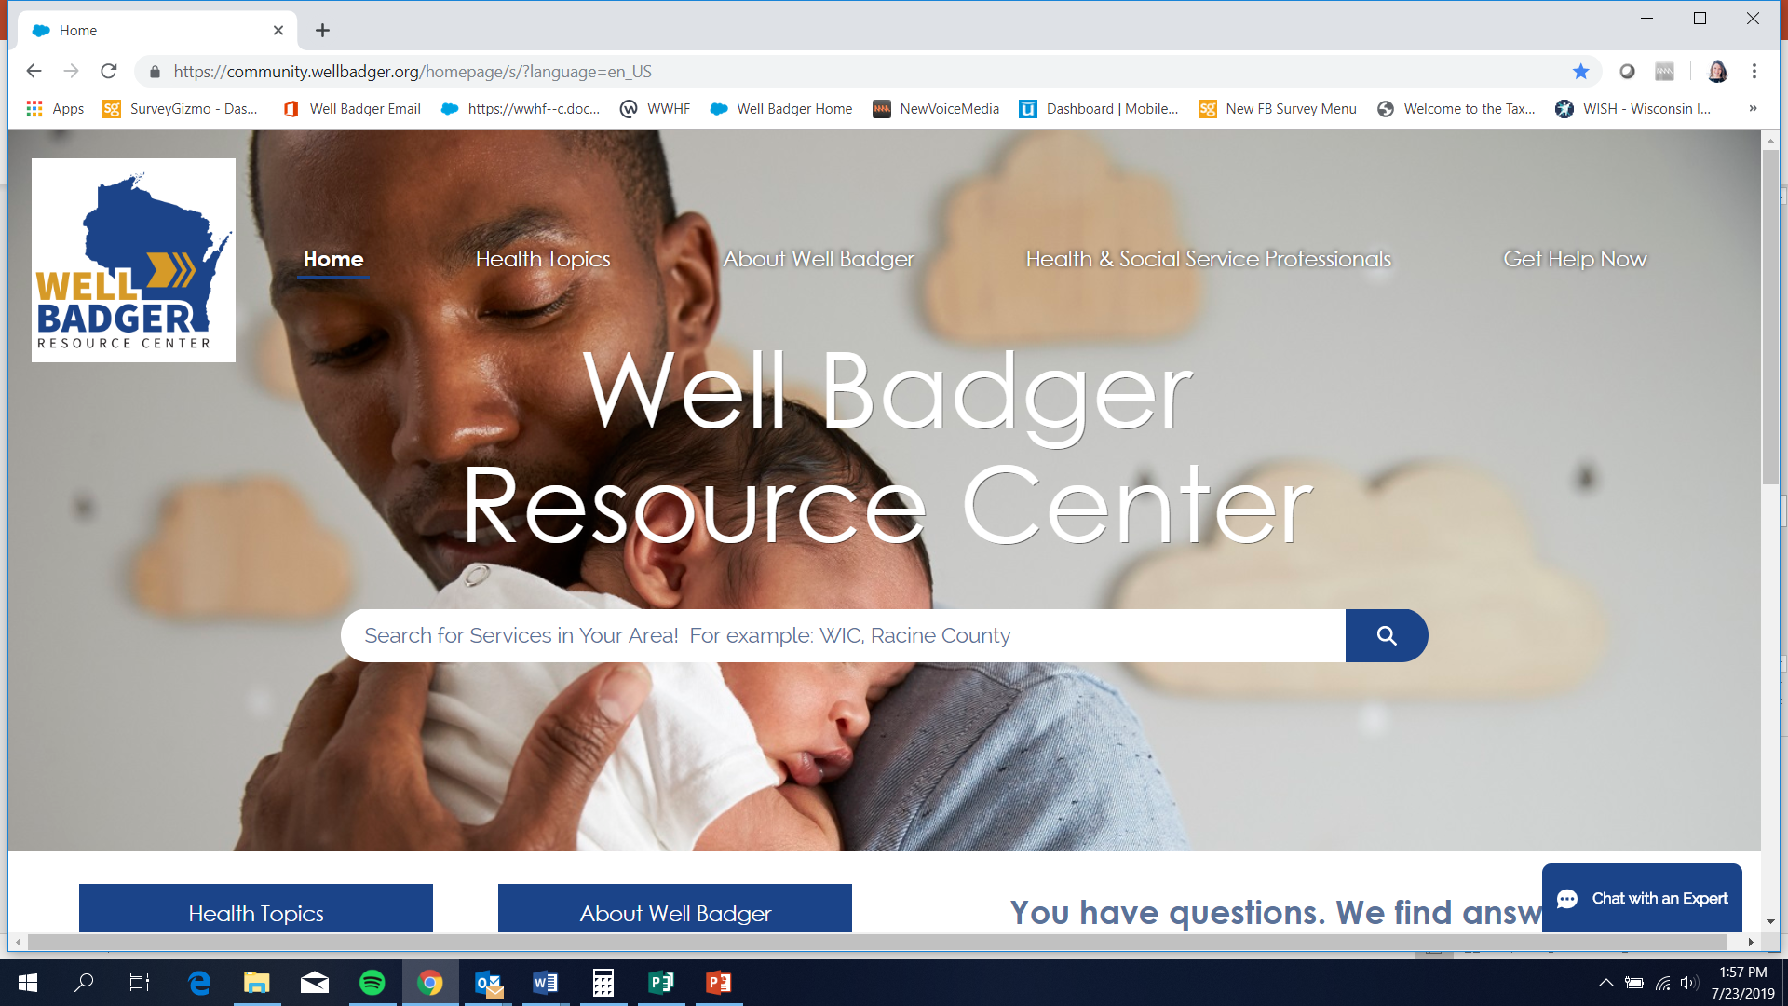
About Well Badger
Well Badger provides health-related information & referral services in two ways:
❶ Connect with our friendly, knowledgeable Certified Resource Specialists
❷ Search our Online Directory with thousands of local, verified health services

Slide 4
Information & Referral Services

Slide 5
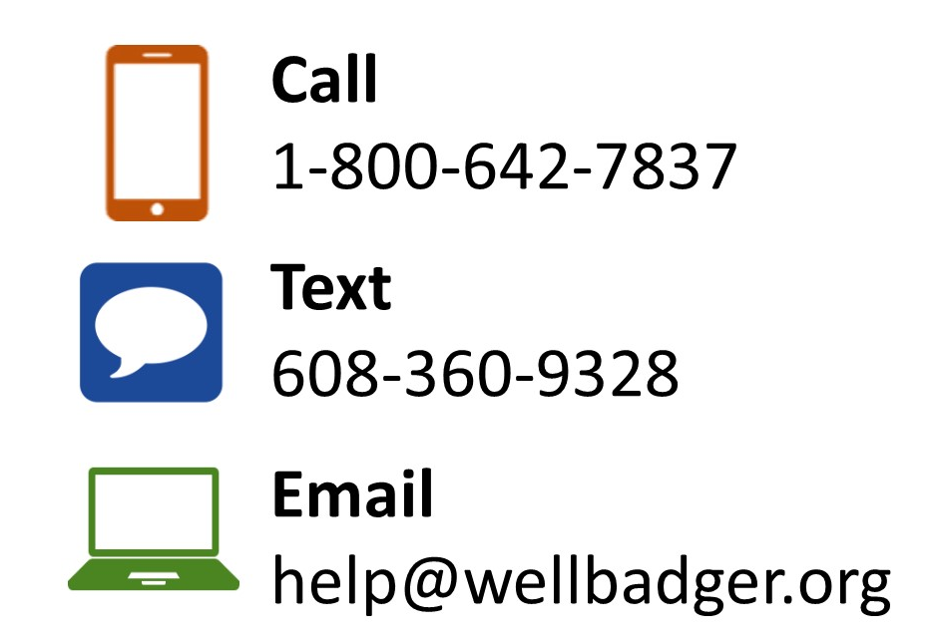

Information & Referral Services
Staffed by Certified Resource Specialists
Available Mon - Fri, 7 AM – 6 PM
After hours inquiries are responded to next business day
Interpretive services available using language line
Individuals can reach out directly OR service provider can call on their behalf

Slide 6
Examples of Questions We Can Help With
I need help finding mental health services for my child.
My family is struggling financially. We need help.
Is my family eligible for programs like WIC, BadgerCare, and FoodShare?
I am looking for respite care for my child with special needs.
I have a lump in my breast, but I don’t have insurance to get it checked out.
Where can I find free or low-cost baby supplies?
We need help understanding programs like Katie Beckett, CLTS, and CCOP.
I just found out that I’m pregnant and don’t know what to do.

Slide 7
How We Help
Well Badger Specialists:
  LISTEN
  Conduct basic eligibility screening
  Provide education about services
  Work with individual to identify and prioritize needs
  Work with individual to find primary and secondary referral site(s)
  Warm transfer if at all possible
  Follow-up 1-2 weeks post initial contact
Cases range from simple, 3 minute interactions to ones that are complex, multi-week
If we don’t know the answer, we will do research and figure it out!

Slide 8
Who We Help
Special focus on pregnant and postpartum women, children and youth with special health care needs, and low income individuals and families
Individuals helped (per year)
Referrals made (per year)
1,700
2,500
Pregnant or
Postpartum
57%
20%
Children & Youth With Special Health Care Needs

Slide 9
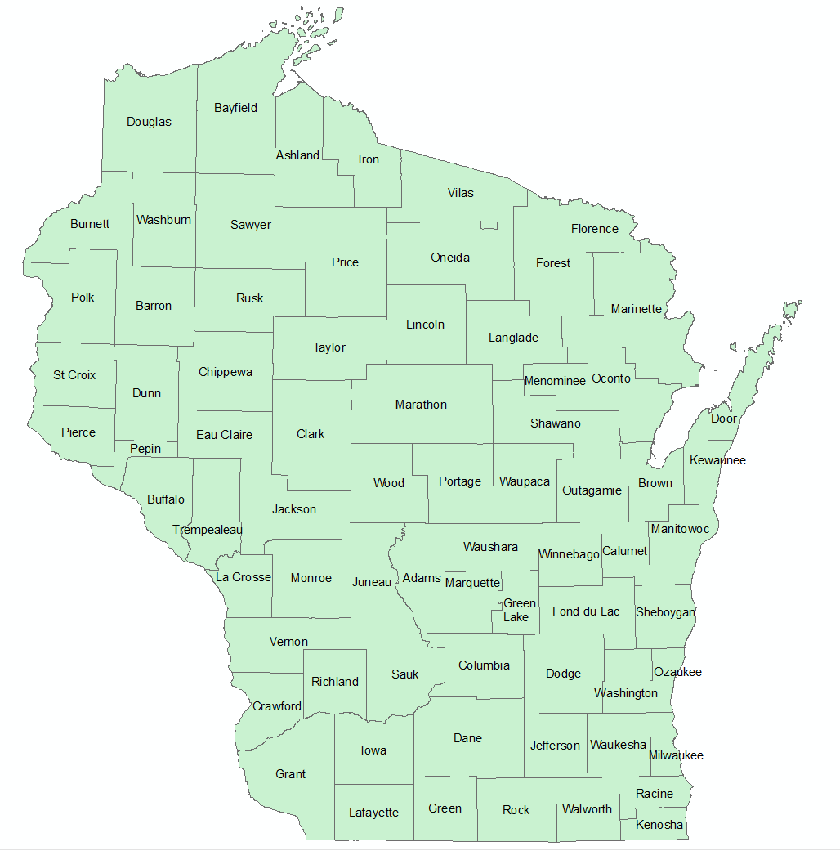
Who We Help
Individuals and families from all 72 counties
Most low-income
2/3 looking for resources for themselves, 1/3 looking for resources for someone else (child, spouse, patient, etc)
Mix of ages, but most under 40
Mix of insurance types, but most BadgerCare
57%

Slide 10
What Families Say About Well Badger
She made sure I was an active participant in making any decisions.
I was directed to the exact resource I needed.
The staff were friendly, helpful, resourceful, and knowledgeable.
She followed up with me to ensure our needs were met.
Feel like it's one of the best resources I've found.
Felt like a human being and not just a number.
This has been a very difficult process for us, and having at least one program go well, without us leaving embarrassed or judged, was heartwarming.

Slide 11
Online Directory

Slide 12
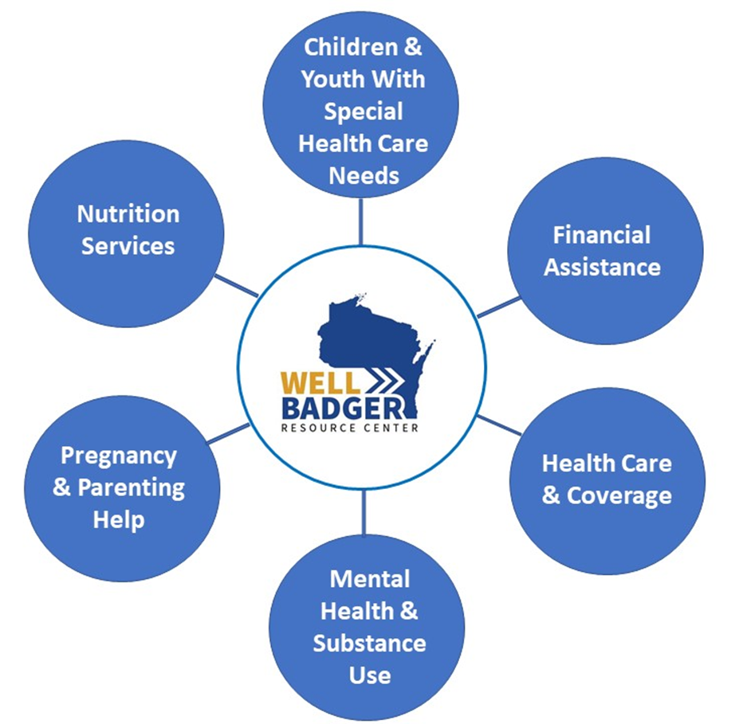
Well Badger Online Directory
Includes thousands of health and social services and programs
Six main topic areas
All services must meet inclusion criteria
All information must be verified by agency that provides the service

Slide 13
How to Use Well Badger Online Directory
www.wellbadger.org
DEMO
Notes:
If you’d like to pull up your phone

Slide 14
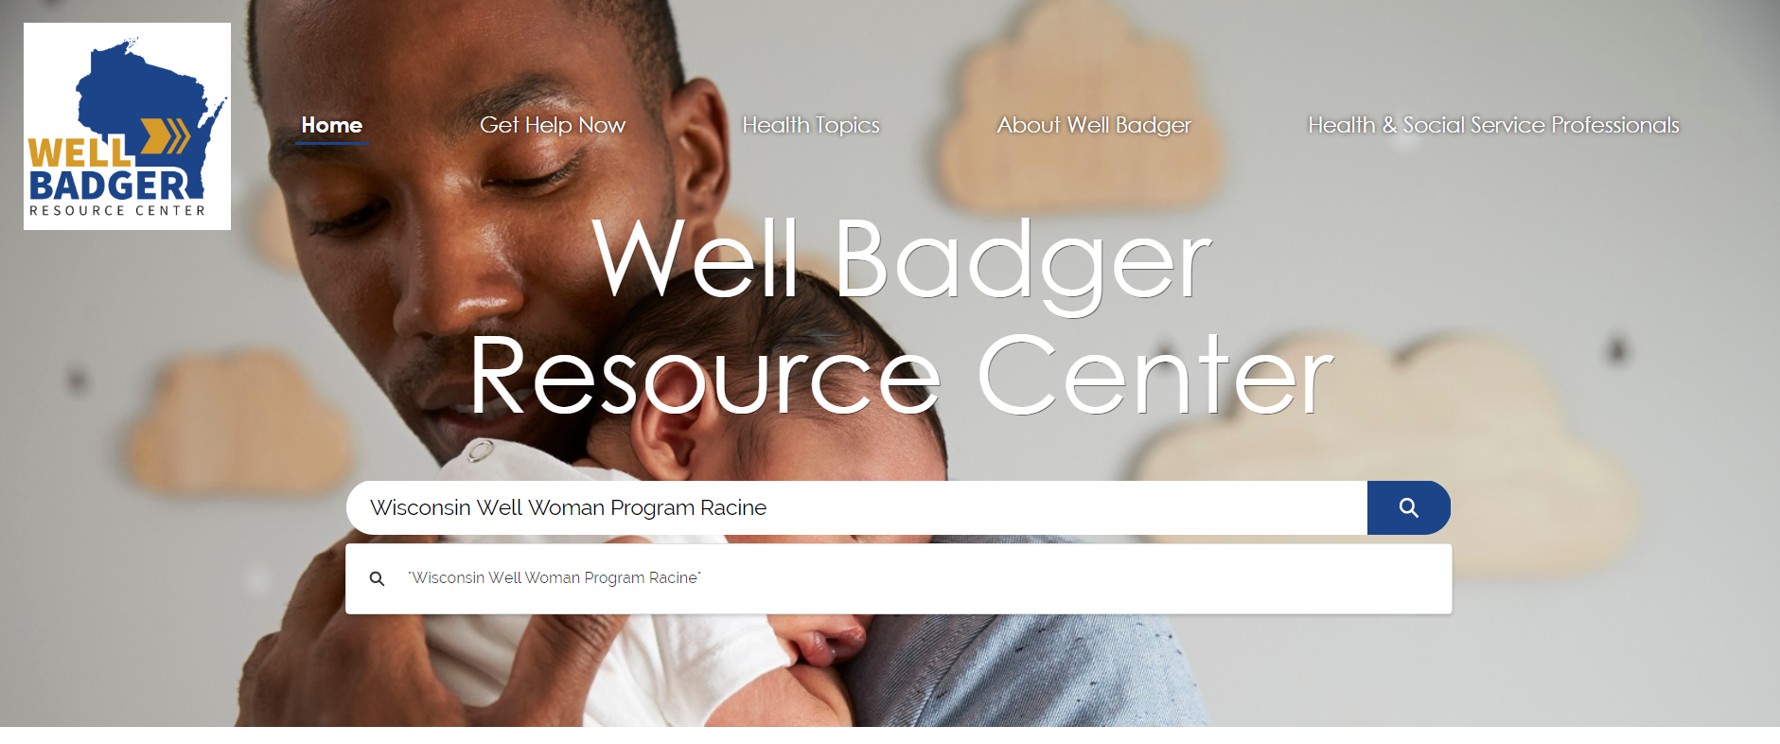
How to Use Well Badger Online Directory
Option #1: Type into the Search Bar

Slide 15
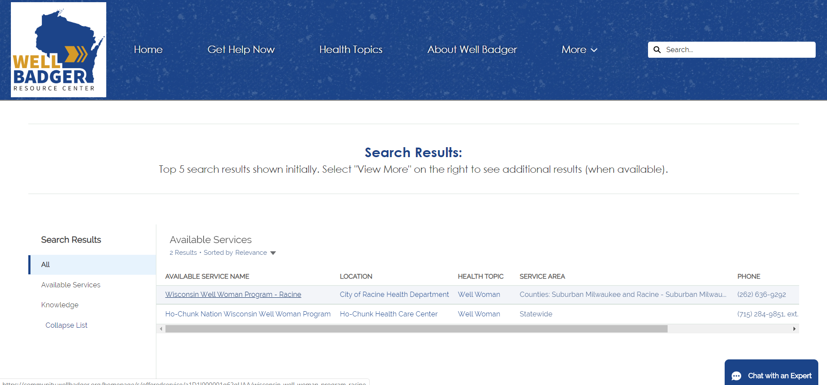
How to Use Well Badger Online Directory
Click on Available Service you want to see

Slide 16

How to Use Well Badger Online Directory
View details about that service

Slide 17
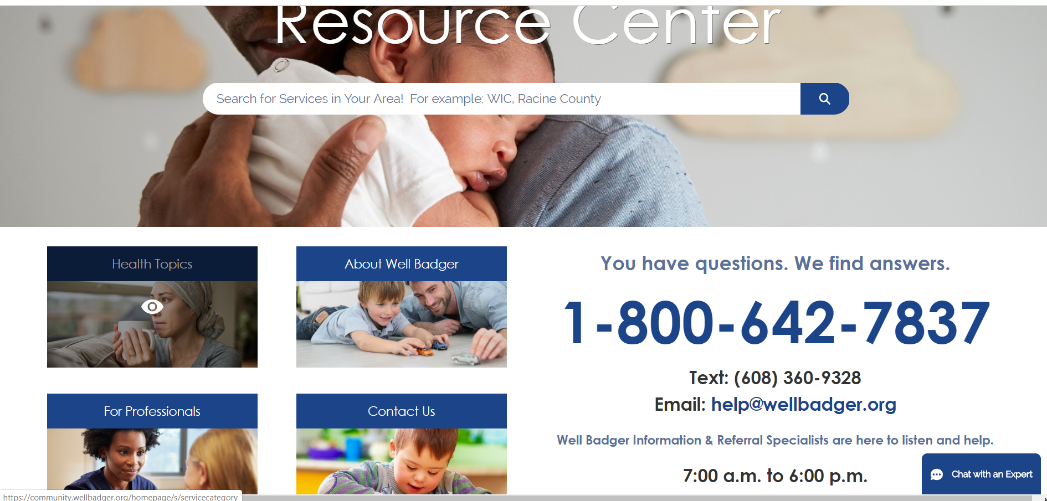
How to Use Well Badger Online Directory
Option #2: Scroll down a bit and click “Health Topics”

Slide 18
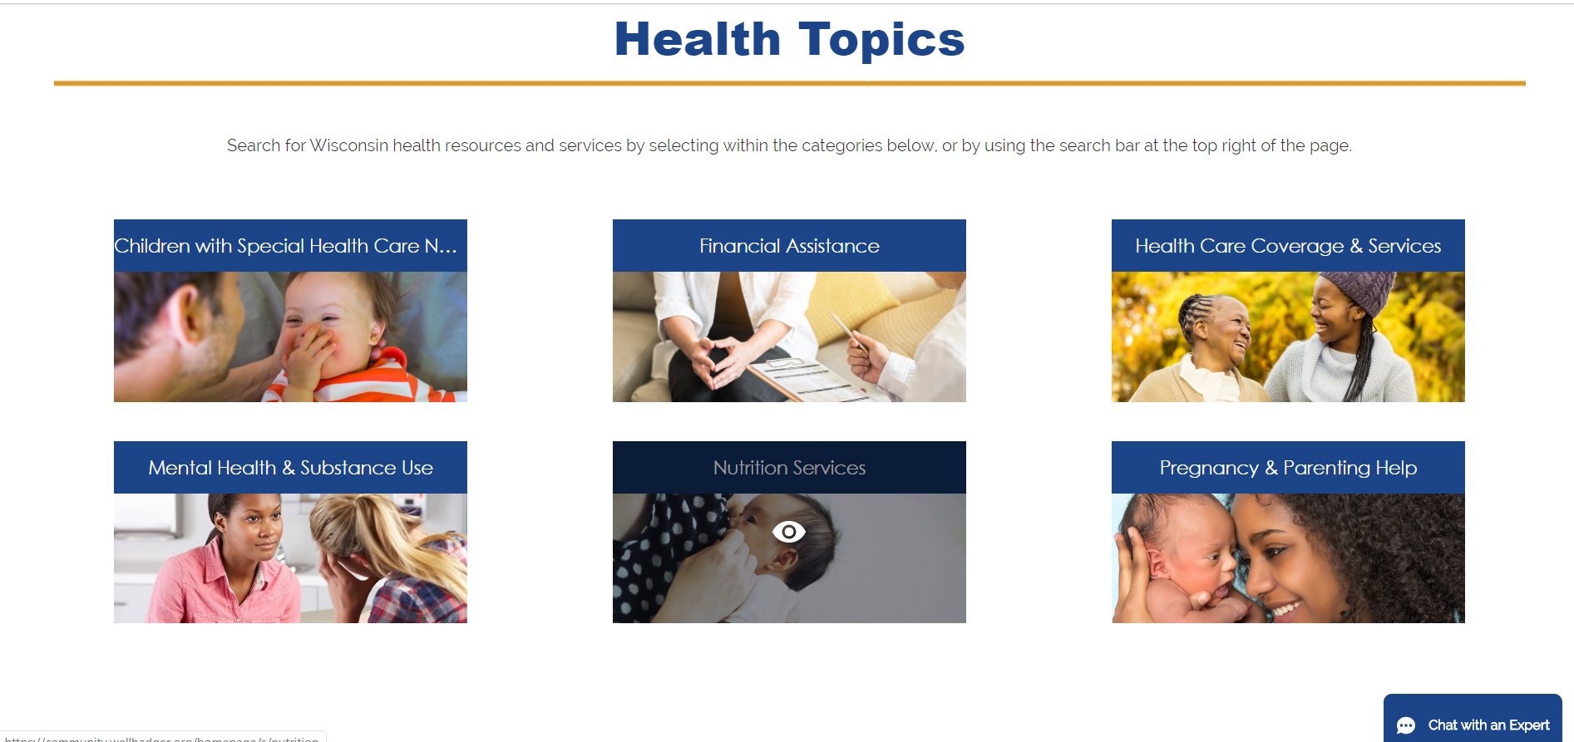
How to Use Well Badger Online Directory
Click the topic you’d like to explore

Slide 19
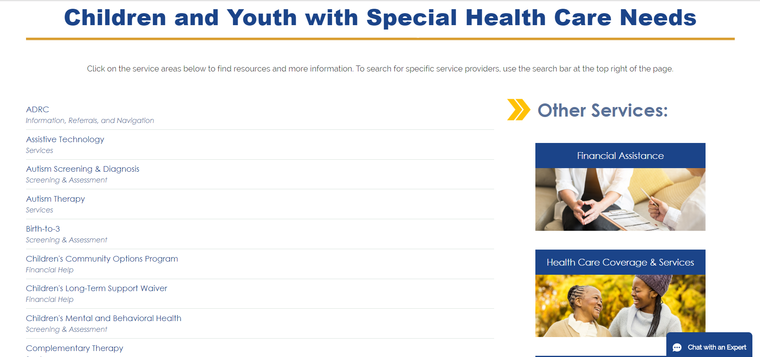
How to Use Well Badger Online Directory
Review all available services under that topic

Slide 20
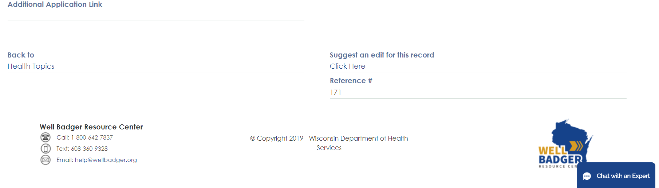
How To Use Online Directory
Need to update your program’s info within the directory?
Scroll to bottom of listing and click “suggest an edit”

Slide 21
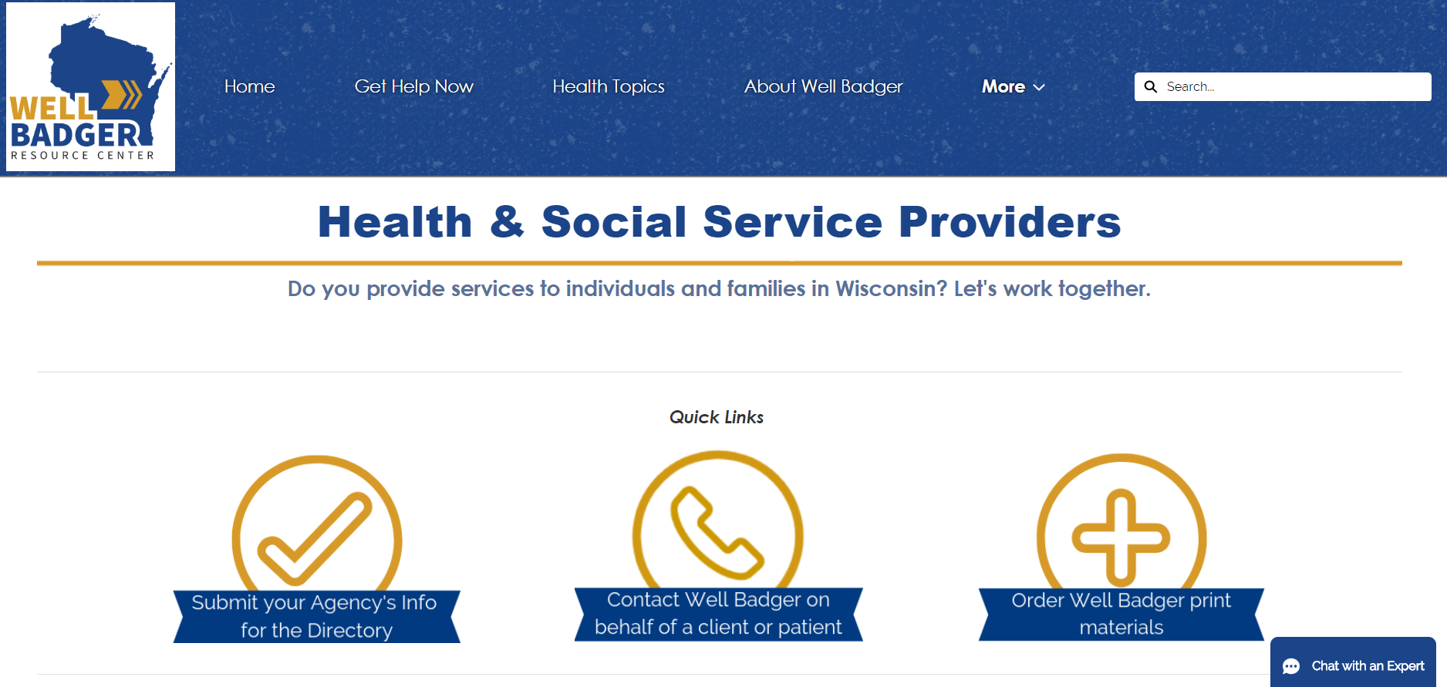
How Can We Help You?
Want to…
Submit your agency’s Information for inclusion in the directory?
Contact Well Badger on behalf of a patient or client?
Order Promo Materials?
Join our listserv?
Visit our Health Professionals Page at wellbadger.org

Slide 22

Future Development
Continue to expand directory
Promotion of electronic I&R (email, chat, text, FB Messenger)
Children’s Mental Health Project
  Identifying and verifying resources
  Building online resource navigator
  Testing with professionals and parents

Slide 23
Other questions or feedback?
Contact us! agencyinfo@wellbadger.org
608-571-1481

Slide 24


Other MCH Programs at WWHF
First Breath is an evidence-based program that helps pregnant women, new moms, and their family members quit smoking
Individuals matched with a local First Breath Quit Coach, Certified Tobacco Treatment and receive:
  Individualized cessation counseling services (face-to-face, phone, & text) through six months postpartum
  Additional focus on creating smoke-free homes and reducing infant exposure to tobacco smoke
  Up to $120 in gift cards
My Baby & Me offers screening, education, brief intervention, and referral services for women at risk of having an alcohol-free pregnancy
In 2020, plans to expand program from alcohol to all substances, including alcohol, marijuana, opioids, illicit drugs, and prescription drug misuse
Questions about these programs?
Contact Kristine Alaniz at kalaniz@wwhf.org

